Slide 1
COVID How-To Guide
Tuesday, 24 March 2020
Paul Latimer – Clinical Consultant Team Lead

Slide 2
Contents
This quick guide will show:
How to create a clinical note for COVID monitoring
How to assign a patient tag to the note
Create a Smart List to identify the location of these patients
Introduction to Live Flow metrics
This guide is not exhaustive, please see your admin guides for detailed information, available on Freshdesk.
Should you need any further guidance please raise a support ticket by contacting support@nervecentresoftware.com
Please note the screenshots in this guide were taken on a server running v6, they may be slightly different to your version

Slide 3
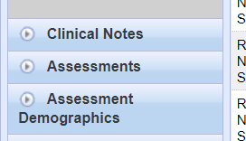
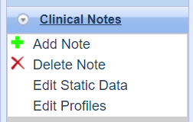
Creating a clinical note for COVID monitoring
1. In the admin pages select ‘Clinical’
Don’t forget to open a Config Session!
2. Select Clinical Notes (this may be called Handover in older versions)
3. Select ‘Add Note’

Slide 4
Creating a clinical note for COVID monitoring
The name of the note field. For instance, “COVID Status”.
Keep the Control field to ‘None’.
This should be set to ‘Visit’ meaning that the note value will only be viewable during this specific visit.
A width can be populated for viewing on the patient list view on desktop, if none is entered then the note field will be auto-sized.
You can either use a Text, or a predefined list of options. If using options each option should be separated using a comma.
Once ‘Add’ is selected then you can add additional information back in the admin page.

Slide 5
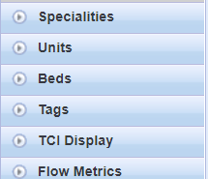
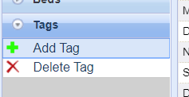
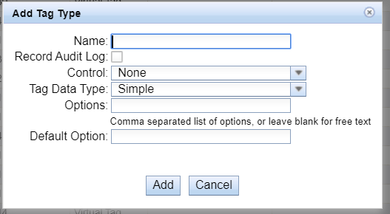
Create the tag
1. Select the ‘Hospital’ option in the admin pages
2. Select ‘Tags’ Option
3. Select ‘Add Tag’
4. Give the tag type a name and select ‘Add’

Slide 6
Create the tag
Select this if you wish to log all changes to the tag in the audit log
Set the Control to a Clinical Note
Set the Short Name. This will be the name that appears on the mobile devices, patient banner and PSAAG
Change the data type to a ‘Virtual Tag’. This allows the clinical note to drive the tag.
Select the colour for the tag by using hex colour codes

Slide 7
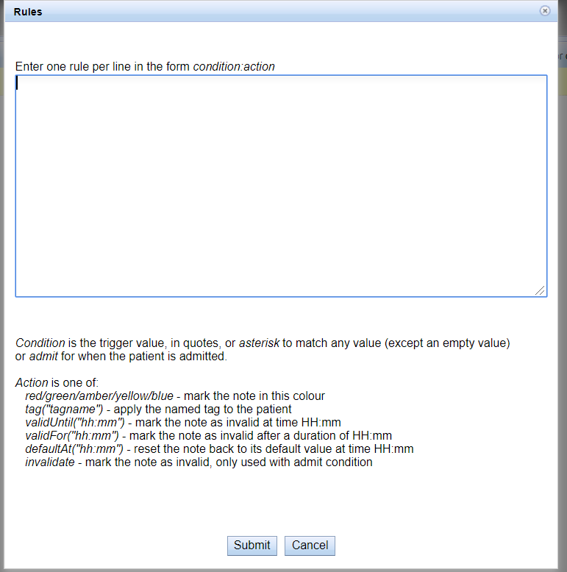
Add the tag to the note
In the Search bar search for the name of the note you have just created, in this case ‘COVID Demo’
All the entries you made on the last page can now be seen.
Double click on the ‘Rules’ option to create options for a patient tag

Slide 8
Add the tag to the note
The ‘Rules’ section allows certain actions to be undertaken. To apply the recently created tag into the Note the following would be correct
"Swabbed":Tag("COVID Swabbed")
"Suspected":Tag("COVID Suspected")
"Confirmed":Tag("COVID Confirmed")
You can also add colours to the note in the patient list view. In this case the COVID Suspected will be Amber, whereas COVID Confirmed will be Red
"Suspected":amber
"Confirmed":red
This is case sensitive and you can change the text before the colon to whatever options you defined to be set up in the clinical note
(note – do not copy and paste from this document into the rules as this may affect the rules)

Slide 9
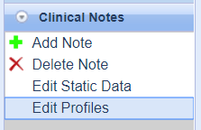
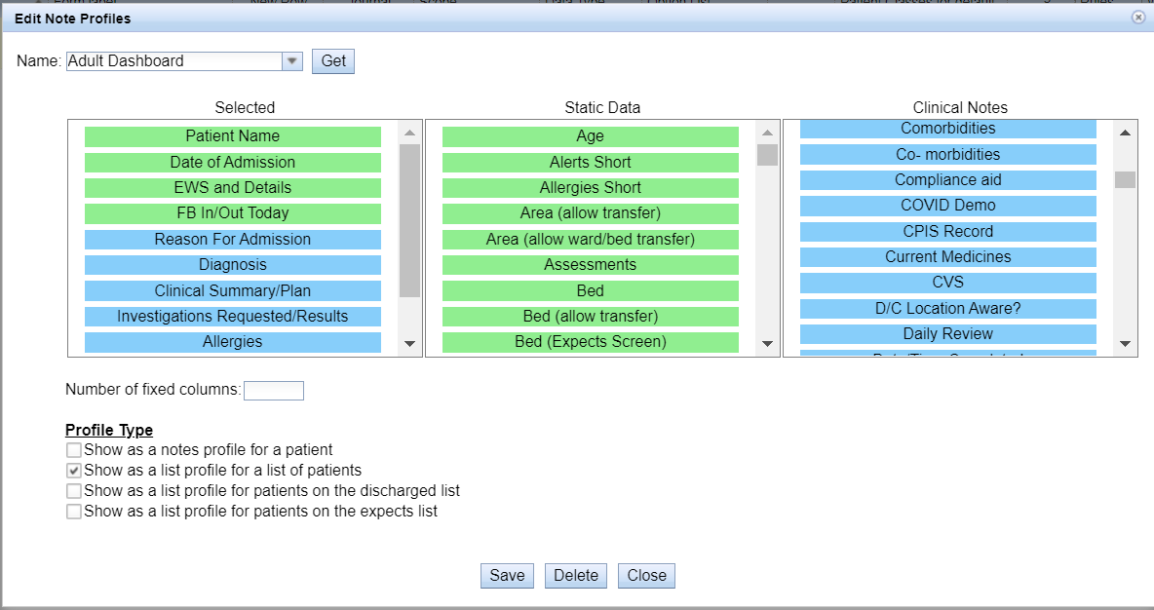
Add the note type to a profile
You can now apply the new note to a profile.
Enter the name of the profile you wish to have the note viewable and select ‘Get’. This brings al the options in the profile, and additional data that can be added – note you can add this to numerous profiles
Drag the new note into the ‘selected’ section in the correct order you wish it to appear

Slide 10
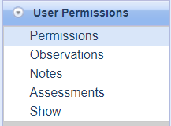
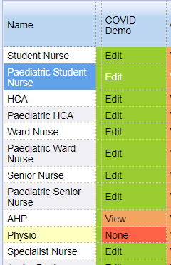
Edit or view the note
There will be some users who do not need to edit the note. The remove this function follow the steps below:
Go to Admin pages
In Admin select ‘User Permissions’
Select ‘Notes’
Scroll across the page to find the note type you have created
All users will default to Edit the note. Double click on the option next to the user type and select either ‘View (allows the user to view but not edit the note), or ‘None’ (removes the note from the user)

Slide 11
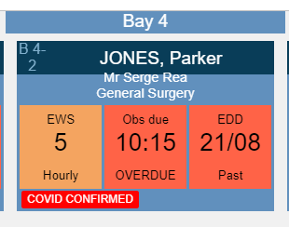
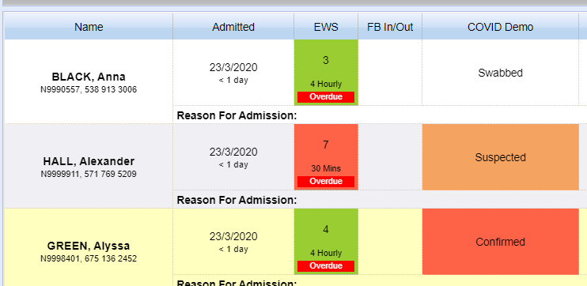
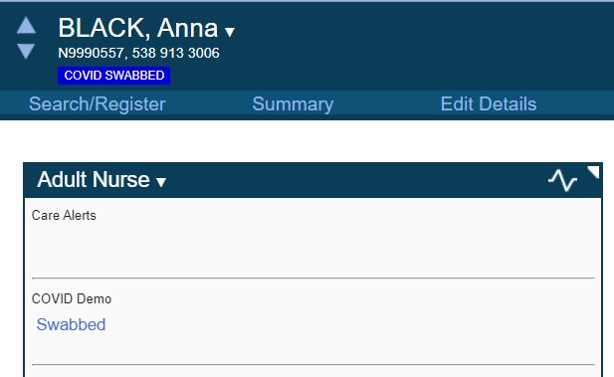
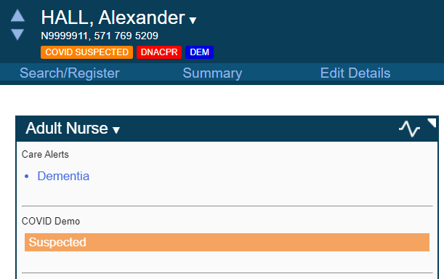
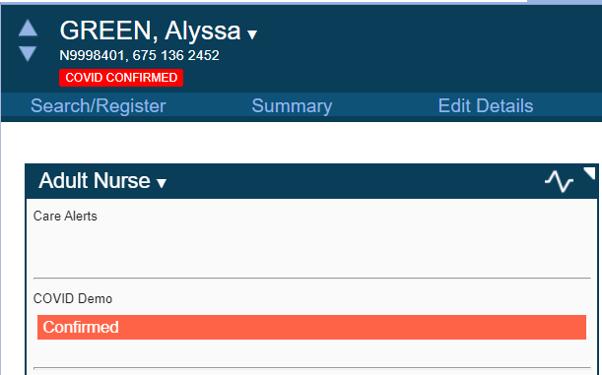
Viewing notes and tags
View on Adult Dashboard profile
View on PSAAG
View on Patient Details page using the Adult Nurse Profile

Slide 12
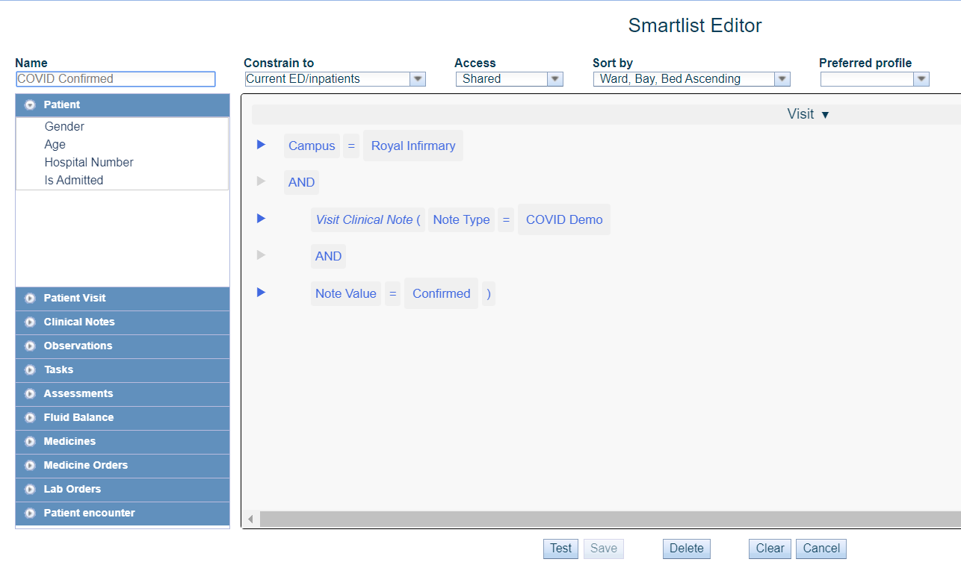
Creating Smart List from the Ward Pages
This opens the smartlist editor. To create a list specific to the clinical note that we have just created:
1. Select ‘Patient Visit’ and choose ‘Campus’.
2. Select the box next to the = sign next to campus and choose the campus you wish to use.
3. Select Clinical Notes.
Select ‘Visit Clinical Note’.
Select ‘Note Type’.
Select ‘Note Value’.
4. Against ‘Note Type’ select the COVID clinical note.
5. Against the ‘Note Value’ Select ‘Confirmed’
6. Press the test button to confirm an accurate list
7. Sort by should be set to Bed Inventory, ascending, in most cases.
8. Ensure ‘Access’ is changed to ‘Shared’ if you want the list to be available to other users
Select the small downward arrow on the right hand side of the page (Ward Pages). Then Select ‘New List’
8
7
2
4
1
5
3
6

Slide 13
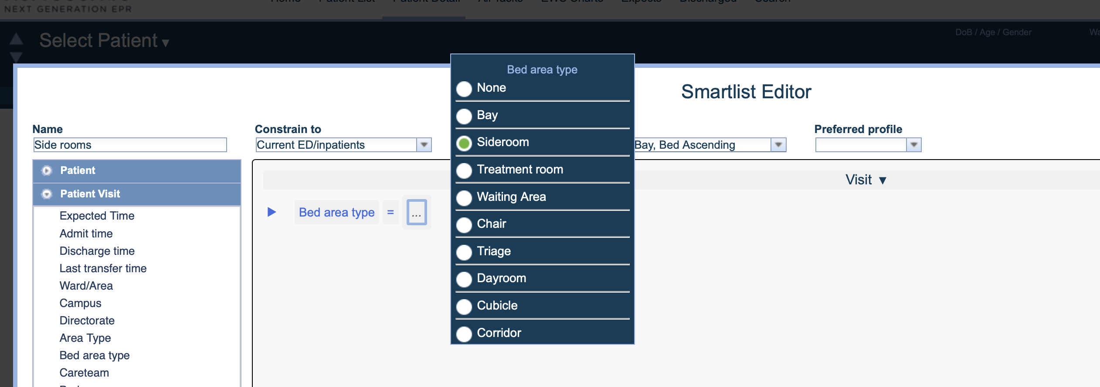
Patients in side rooms*
Identifying patients in side rooms by using a list is undertaken by following the same steps in an earlier slide to open a list to create, then select patient visit – bed type – select Siderooms.
*For this feature to be available the bed inventory must be set up with siderooms.

Slide 14
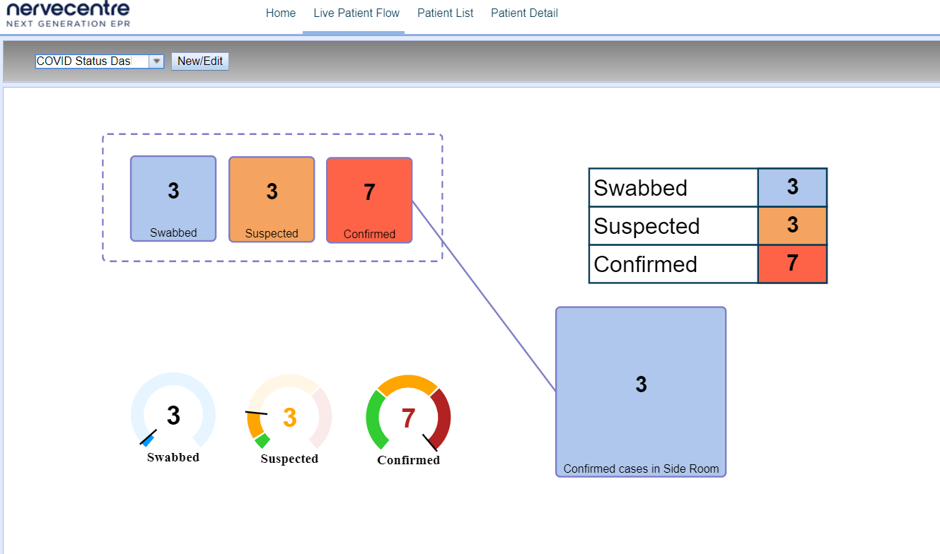
This dashboard displays the same data from the clinical notes that were earlier created.
There are numerous ways to show the data, either as squares, tables or gauges.
These steps are for v5.0 and above of Nervecentre

Slide 15
Create Live Flow Dashboards
Live Flow Dashboards are created in a similar way to Smart Lists.
If the user was in the Admin pages, they’ll need to log out, select Clinical, and log back in.
Select the ‘Three Dots’ from the right top corner of the page.
Select Live Flow Pages
Select ‘Live Patient Flow’ followed by New/Edit to create a new flow, or select the name of the flow from the drop down list then select New/Edit to edit an existing flow

Slide 16
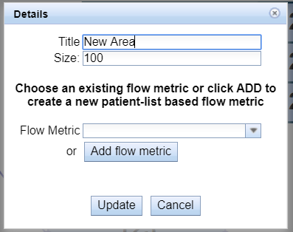
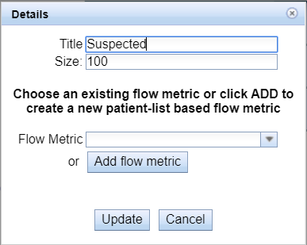
Select one of the options on the left hand side to use either a box, text, table or gauge.
Double click on the option you have chosen, this will open a new box
Give the metric a name, and select ‘Add flow metric’. Note that if the metric has already been created select the drop down next to ‘Flow Metric’ and choose the desired metric
These steps are for v5.0 and above of Nervecentre

Slide 17
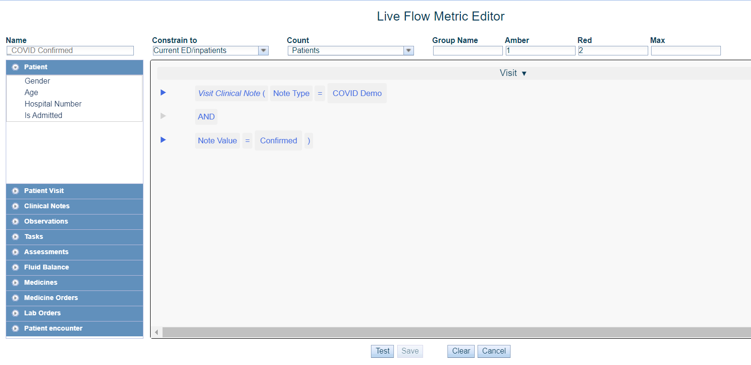
Create the metric from the clinical note, in the same way as the smart list earlier.
Add some colour to the metric so that if numbers exceed a threshold this can be seen
You must select ‘test’ before you can save ensuring that the metric is viable. If you do not select test then the save button is disabled.
Once you have pressed saved the metrics will be saved (note the values on the live flow default to 123). Scroll down the page and select ‘Run’. This will show the accurate data. Then press save, and close

Slide 18
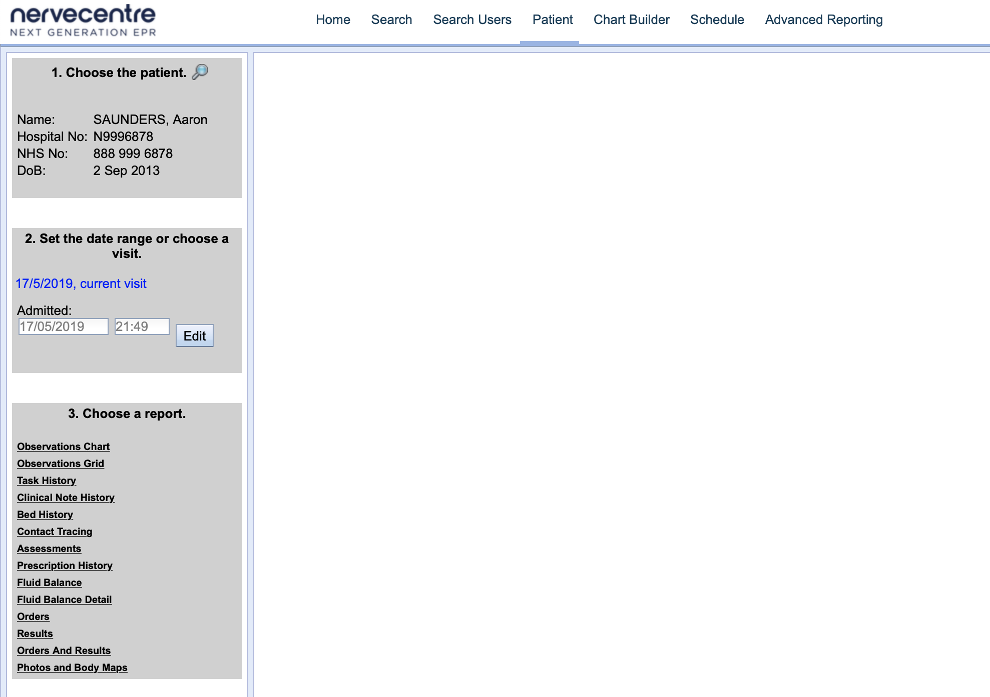
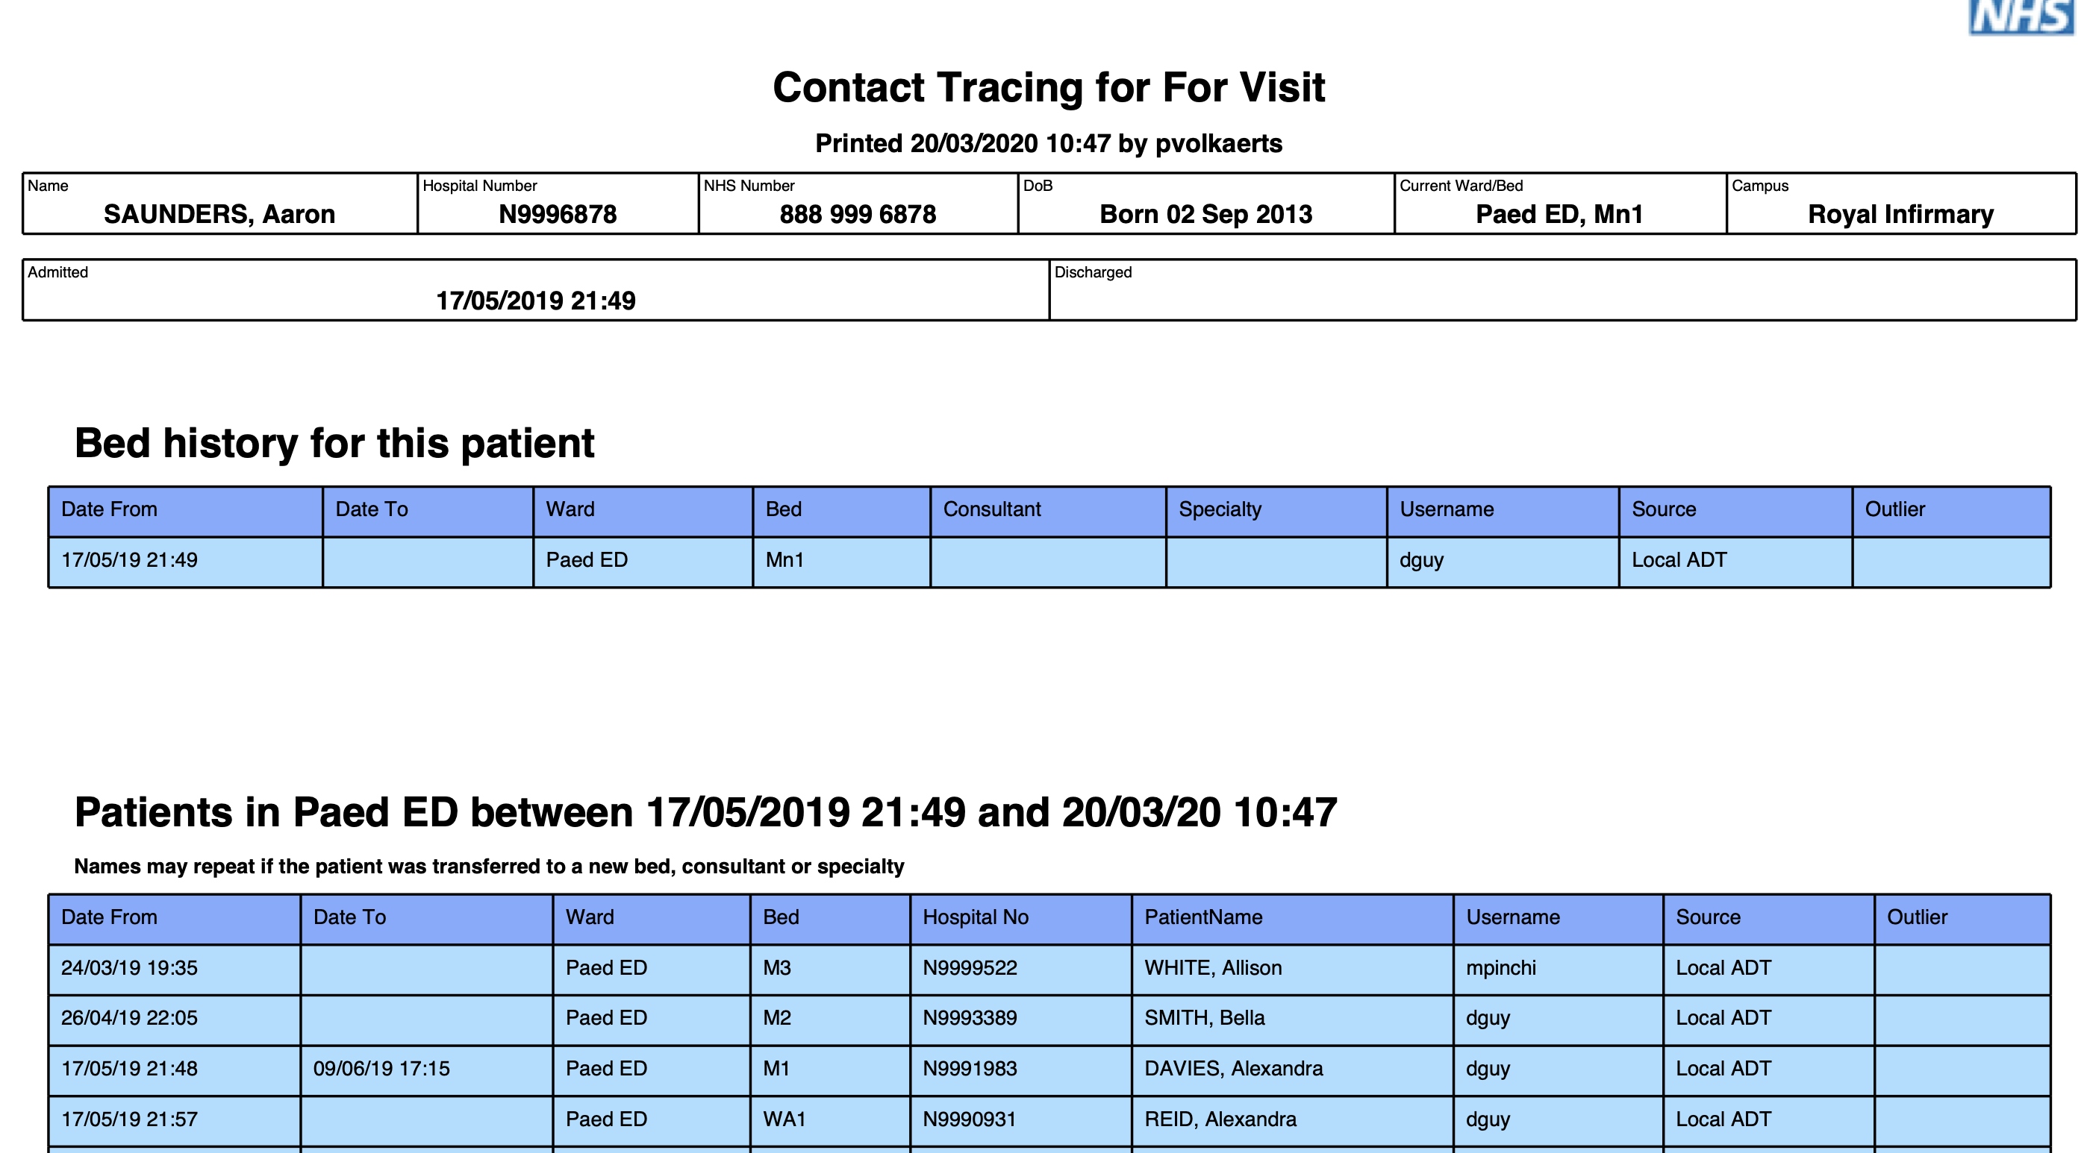
Contact Tracing
Contact Tracing is found in the reporting pages, if you are logged in to either the Admin or Clinical pages, you must log out, select Reporting, then log in again .
Select ‘Patient’

