Slide 1
Configurations to support Covid-19 response
Monday, 23 March 2020

Slide 2
Introduction
We want to pull together the good ideas and configurations that Trusts use to help with the Covid-19 response, and ensure all Trusts are able to benefit
For help – raise a ticket to support@nervecentresoftware.com

Slide 3
How we will help
Sharing best practice between Trusts e.g. this webinar
Provide simple how-to guides e.g. these slides, backed by support
All license restrictions temporarily lifted, just raise a support ticket
Individual support where we can scale to it, group support via webinars where there is common demand

Slide 4
Features which may help
COVID-19 Dashboards, lists, live-flows
Contact tracing
H@N – Daytime
Photography
Covid assessment?
Referrals to cleaning teams?
Others?

Slide 5
Add COVID status to dashboards

Slide 6
1. Create clinical notes and Tags

Slide 7
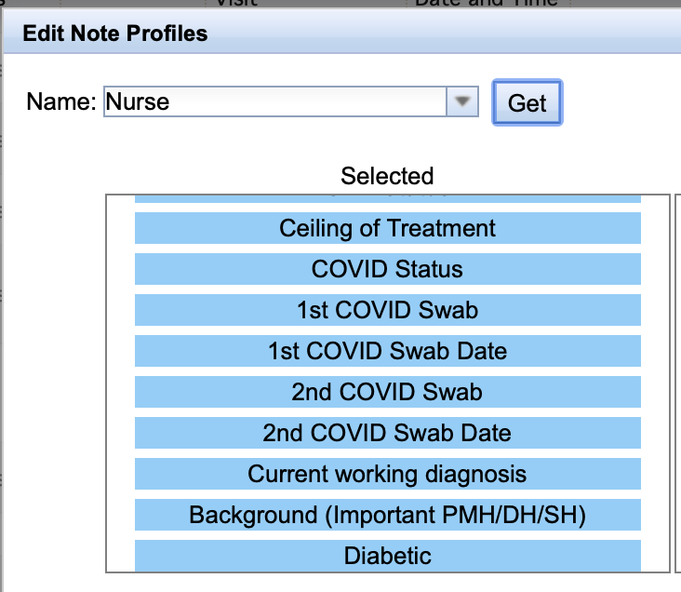
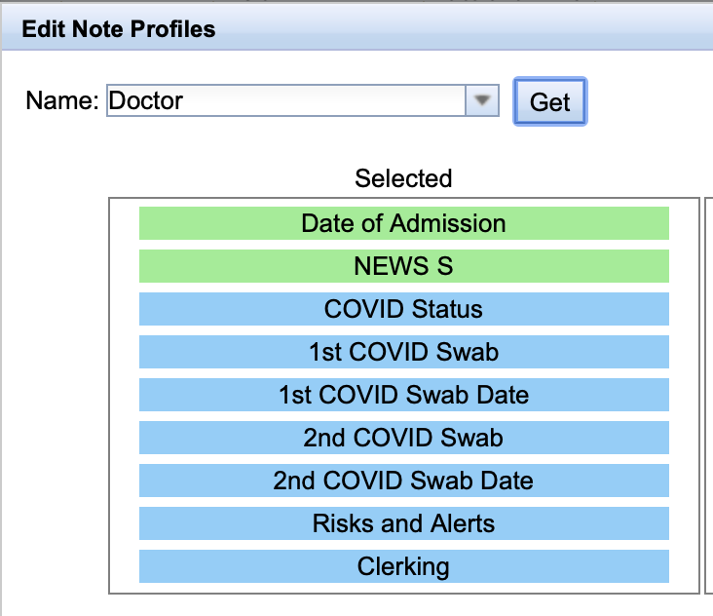
2. Create a new list profile, add to existing nurse/doctor profiles

Slide 8
3. Create Smart-lists

Slide 9
4. Example Smart List

Slide 10
5. Create Live Flow Dashboards

Slide 11
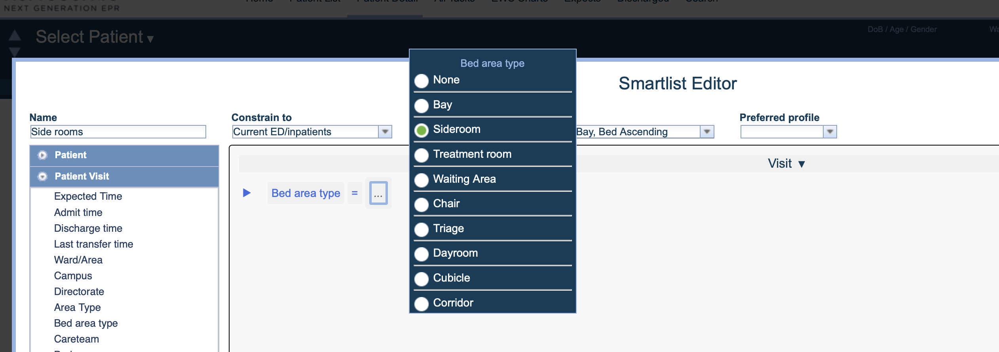
Smart-lists – Patients in siderooms

Slide 12
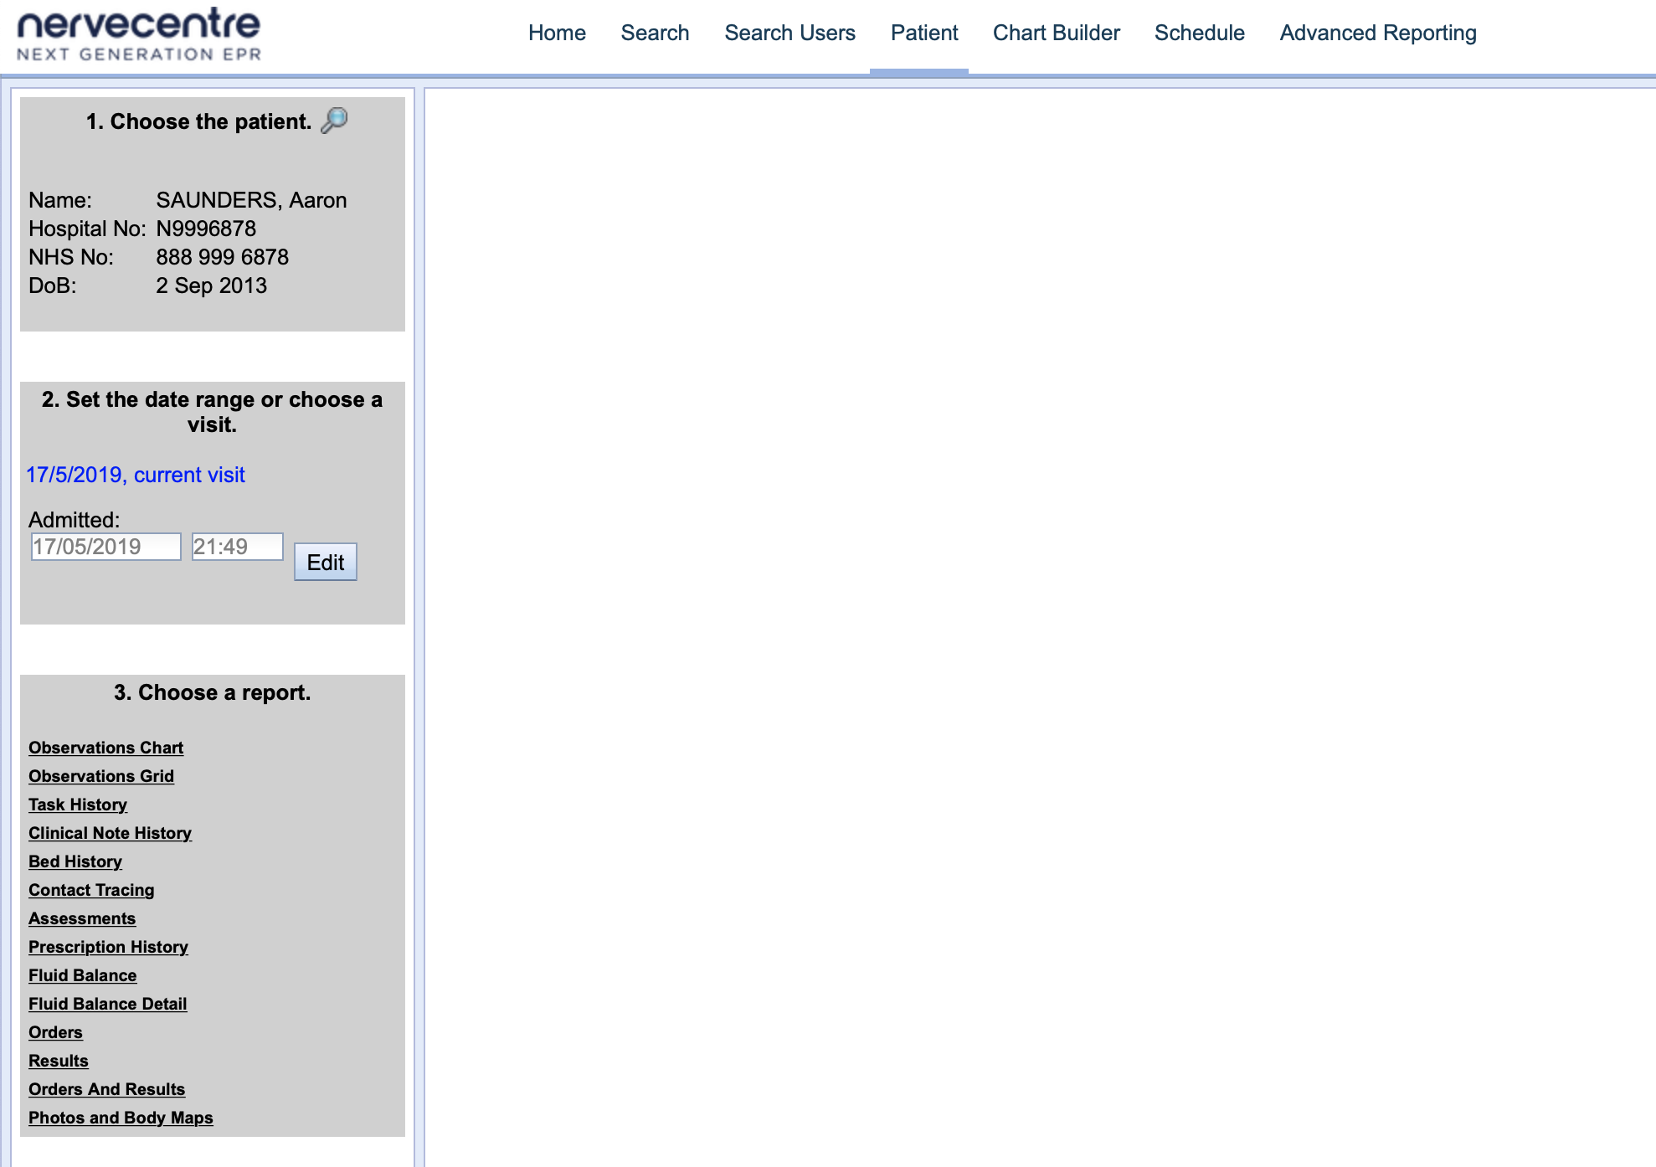
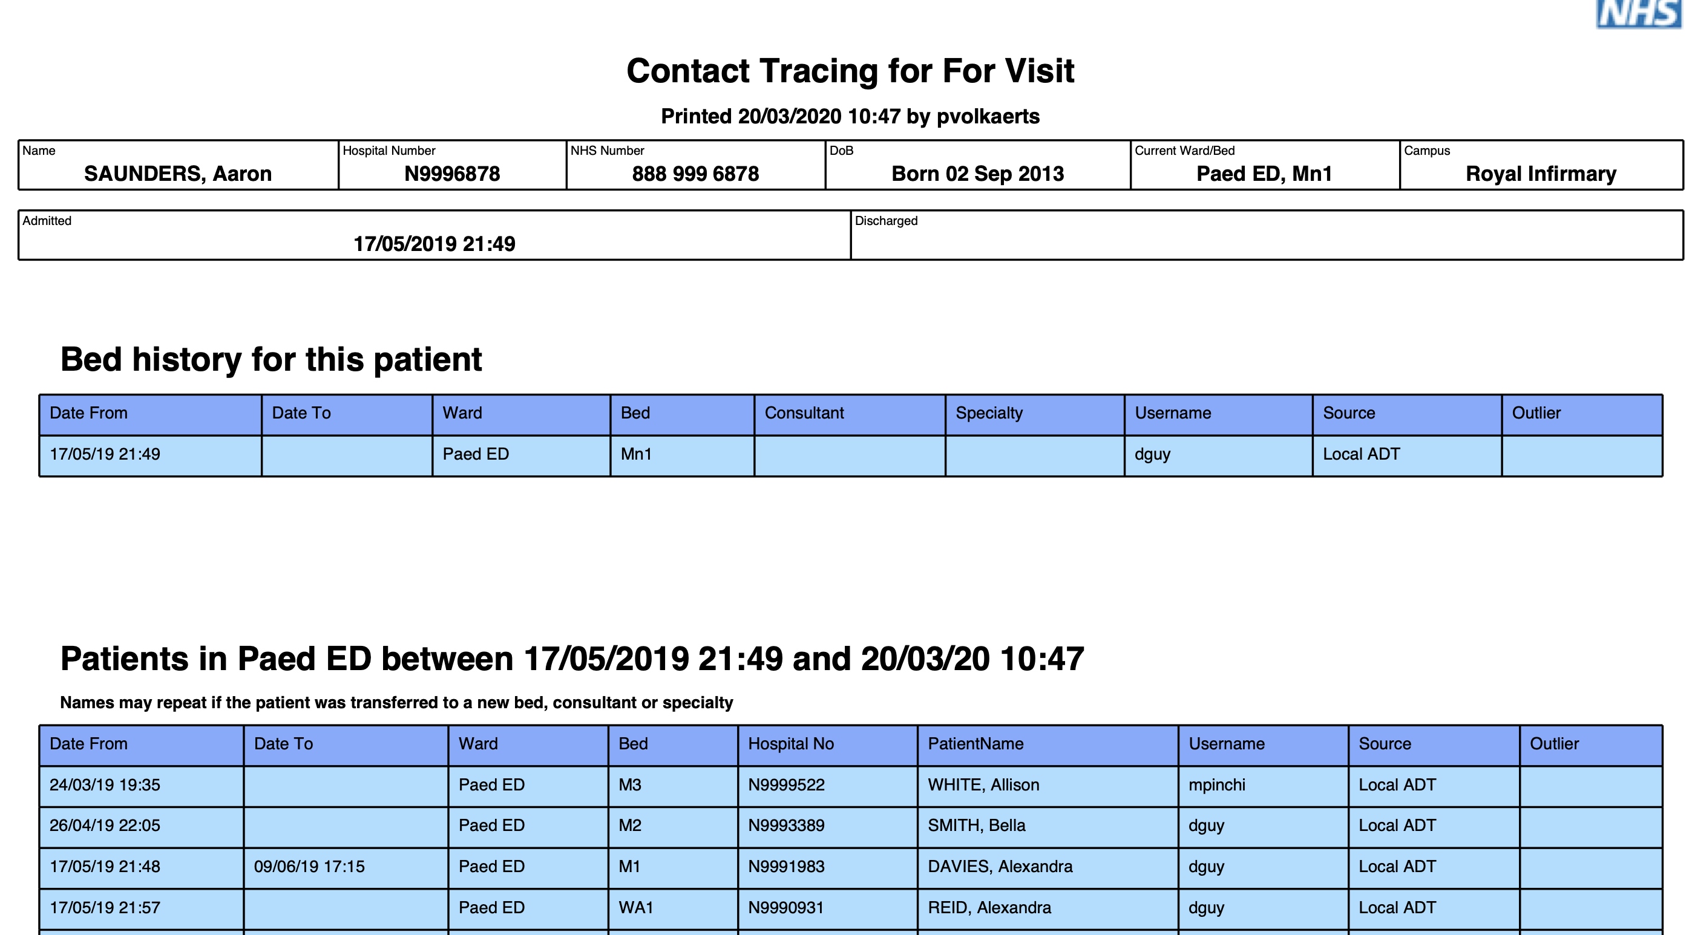
Contact Tracing

